Slide 1
Modernize your database with SQL Server 2019
Bob Ward, Microsoft
bobward@microsoft.com
http://aka.ms/sqlworkshops

Slide 2

The Workshop
Module 1: Why SQL Server 2019
Module 2: Big Data Clusters and Data Virtualization
Module 3: Intelligent Performance
Module 4: New Security Capabilities
Module 5: Mission Critical Availability
Module 6: The Modern Development Platform
Module 7: SQL Server on Linux
Module 8: SQL Server Containers and Kubernetes
Module 9: What else is New
Module 10: Migration and Next Steps

Slide 3
Module 1: Why SQL Server 2019?

Slide 4
SQL Server end of support
SQL Server 2008 and 2008 R2 will no longer be supported starting on July 9, 2019.
 | Current support level | End mainstream | End extended
SQL Server 2014 | Currently supporting all versions | July 9, 2019 | July 9, 2024
SQL Server 2012 | SQL Server 2012 SP2+ is in mainstream support until CY 2017 | July 11, 2017 | July 12, 2022
SQL Server 2008 and SQL Server 2008 R2 | SQL Server 2008 and 2008 R2 are in extended support which includes security updates, paid support, and requires purchasing non-security hotfix support | July 8, 2014 | July 9, 2019
SQL Server 2005 | SQL Server 2005 support ended on April 12, 2016 | April 12, 2011 | April 12, 2016
Learn more about the SQL Server support lifecycle: support.microsoft.com/lifecycle/

Slide 5
Built on the innovation of SQL Server 2016 and 2017
SQL Server 2016
Query Store
SQL Server 2017
Linux and Containers
Adaptive Query Processing
Temporal Tables
JSON
Always Encrypted
Dynamic Data Masking
Row Level Security
It Just Runs Faster
Automatic Tuning
Graph database
Python
R and Machine Learning
Clusterless Availability Groups
Polybase

Slide 6


Modernize on premises with SQL Server 2019
Now with big data clusters
Intelligence over any data
Choice of platform and language
Industry-leading performance
Most secure over the last 8 years⁵
Insights in minutes and rich reports
SQL
+
Analytics over structured and unstructured data with the power of SQL and Apache Spark
T-SQL
Java
C/C++
SCALA
Node.js
C#/VB.NET
Python
Ruby
.NET core
#1 OLTP performance¹
#1 DW performance on 1TB², 10TB³, and 30TB⁴
The best of Power BI and SQL Server Reporting Services in Power BI Report Server
In-memory across all workloads
Most consistent data platform
Private cloud
1/10th the cost of Oracle
Public cloud
All TPC Claims as of 1/19/2018.
¹ http://www.tpc.org/4081; ² http://www.tpc.org/3331; ³ http://www.tpc.org/3326; ⁴ http://www.tpc.org/3321; ⁵ National Institute of Standards and Technology Comprehensive Vulnerability Database
Notes:
That’s not all it can do. SQL Server 2017 continues to deliver industry-leading capabilities:
Our latest performance benchmarks on Windows and Linux blow away our old records.
OLTP – We have #1 OLTP TPC-E performance
DW: And, we have the fastest performing DW. With best price/performance.
We offer the most secure database.
According to US National Institute of Standards and Technology (NSIT), we have had fewer vulnerabilities over the last 7 years than Oracle or IBM
Fewer vulnerabilities mean less patching for you!
SQL Server is the first commercial database with Advanced Analytics using R and Python built-in.
Why does this matter to you?
Now you can use SQL Server to operationalize your data science models in a secure and performant way
Use native T-SQL commands to score data in near real-time
And unlike our competitors, mobile BI on every device comes built-in. Or add access to powerful, self-service BI visualizations through Power BI - at a fraction of the cost of our competitors.
SQL Server 2017 gives you your choice of platform and language, and the most consistent on-prem to cloud environment.
And it does all this for 1/10th the cost of Oracle

Slide 7




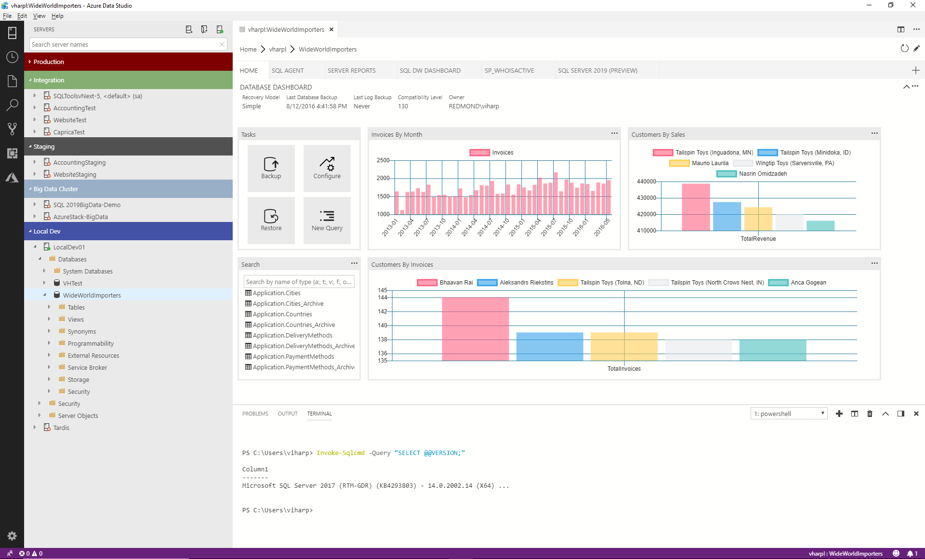

SQL SERVER 2019
Key New Functionality
ciphertext
Polybase v2
Query
SQL
101001010110
Secure Enclaves
Intelligent Query Processing
Learn
Memory grant
Enclave
plaintext
Run query
Built-in Machine Learning and Extensibility
R
Azure Data Studio
Modern Platforms

Slide 8
The Azure Data Studio tools experience
Azure Data Studio is a lightweight, open source, cross-platform graphical management tool and code editor
Enable a modern DevOps experience for database developers and DBAs on their platform of choice​
Simplify development, configuration, management, monitoring and troubleshooting for SQL databases on-premises and in the cloud
Use SQL Server Management Studio 18.0 Preview to access, configure, manage, and administer all SQL Server components
TO BE REPLACED
Static Data Masking
Query Tuning Assistant
Notes:
TODO: We will put in a new slide from Vicky and Alan here for the overall tools experience

Slide 9
Module 2: Big Data Clusters and Data Virtualization
Notes:
Note: Right now I have slides from our main deck we have been using. We need to look at Buck’s slide from Day 2 to see if and what we want to plug in here.

Slide 10
SQL Server 2019 enables intelligence over all your data
Integrating all data
Managing all data
Analyzing all data
Unified access to all your data with unparalleled performance
Easily and securely manage
data big and small
Build intelligent apps and AI with all your data
Simplified management and analysis through a unified deployment, governance, and tooling
Notes:
Data is the new currency. We are constantly seeing a proliferation of data into all segments of our lives in various form factors. Data plays a key part in our lives whether it is hosted in a private data center or a public cloud and even in the devices at the Edge. I currently have various forms of data being exchanged between my cell phone, my home automation devices and even the fitbit that I am wearing. This data EXPLOSION that we are experiencing in every aspect of our lives requires us to be able to converge disparate data sets from different sources whether it is relational, non-relational or even unstructured into a single data hub to gain meaningful insights. As you saw from our announcements yesterday, we are introducing a unified data platform that will be able to talk to all data within your data to allow you to derive valuable business insights from your data estate. This allows you to create a data virtualization layer without the need to move data from one service to the other for the purpose of insights. Not only do you get to manage your data from a single place but you also have the ability to query using Apache Spark and T-SQL.

Slide 11
All on a unified data services platform
Connect to all of your data
Including Relational, noSQL, Hadoop
Create intelligence from all your data
Using Apache Spark and SQL
Manage this through a single pane of glass
With Azure Data Studio

Slide 12
SQL Server 2019 big data, analytics, and AI
Data virtualization
Managed SQL Server, Spark, and data lake
Complete AI platform
Admin portal and management services
Integrated AD-based security
Analytics
T-SQL
Apps
REST API containers for models
SQL Server External Tables
SQL Server
Spark
SQL Server
ML Services
Spark & Spark ML
Compute pools and data pools
Scalable, shared storage (HDFS)
Open database connectivity
NoSQL
Relational databases
HDFS
External data sources
HDFS
Combine data from many sources without moving or replicating it
Scale out compute and caching to boost performance
Store high volume data in a data lake and access it easily using either SQL or Spark
Management services, admin portal, and integrated security make it all easy to manage
Easily feed integrated data from many sources to your model training
Ingest and prep data and then train, store, and operationalize your models all in one system
Notes:
Amit starts here

Slide 13
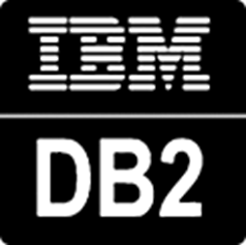




SQL Server is the hub for integrating data
Easily combine across relational and non-relational data stores with no data movement
Analytics
T-SQL
Apps
SQL Server
PolyBase external tables
ODBC
NoSQL
Relational databases
Big data
Excel
Cosmos DB
Intelligence over all data
Notes:
Specifically, SQL Server 2019 users can now query across relational and non-relational data stores including Oracle, Teradata, Mongo etc
Besides supporting Hadoop, now PolyBase will let you query over RDBMS, NoSQL and generic ODBC sources.

Slide 14
Scale out big data compute and storage
SQL Server 2019 includes Spark and HDFS, enabling you to read and write directly in HDFS using SQL Server or Spark ^{NEW}
Elastically scale compute and storage on demand using the Kubernetes architecture ^{NEW}
Apps, BI, and analytics access all your relational and big data through the SQL Server master instance using T-SQL ^{NEW}
Scale-out data marts combine and cache data from relational and non-relational data sources for fast querying ^{NEW}
Custom apps
BI
Analytics
SQL
SQL Server master instance
Spark
SQL Server
Spark
SQL Server
Spark
SQL Server
HDFS Data Node
HDFS Data Node
HDFS Data Node
Kubernetes pod
Node
Node
Node
Persistent storage
Intelligence over all data
Notes:
Easily scale your SQL Server and Big Data storage using HDFS-based storage pools
Enable SQL Developers to build applications consuming Enterprise Data Lakes
Enable Business Analysts to reason over ALL Data using SQL query
Enable the use of existing eco-system of SQL Server tools and Apps to access and analyze enterprise data
Eliminate the need for data movement through data virtualization and HDFS data-marts

Slide 15



Build and End-to-End AI Application
Ingest
Store
Prep & train
Model & serve
Logs, files and media
(unstructured)
SQL Server data pools
SQL Server master instance
Predictive apps
Sensors and IoT
(unstructured)
HDFS
Business/custom apps
(Structured)
SQL Server master instance
SQL Server ML Services
REST API containers for models
BI tools
Simplified management and analysis through a unified deployment, governance, and tooling
Intelligence over all data
Notes:
Easy tooling to ingest, store, prep & train, model and serve high velocity using unified data management
Spark streaming in the box
Data preparation tools
Integrated Jupyter notebooks

Slide 16

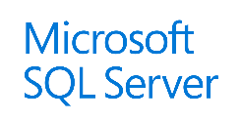


SQL Server Big Data Cluster Architecture
Custom apps
BI
Analytics
Cluster
SQL
SQL Server master instance
External data sources
Compute pool
Compute pool
Compute pool
Directly read from HDFS
SQL Compute Node
SQL Compute Node
SQL Compute Node
SQL Compute Node
…
SQL Compute Node
Data mart
Storage pool
SQL Data Node
SQL Data Node
Spark
SQL Server
Spark
SQL Server
…
Spark
SQL Server
HDFS Data Node
HDFS Data Node
HDFS Data Node
IoT data
Storage
Storage
Kubernetes pod
Node
Node
Node
Node
Node
Node
Node
Persistent storage
Notes:
TODO: Should we replace this slide with Buck’s overall architecture? One thing missing here is the control plane

Slide 17
Module 2 Activity: The SQL Server Data Hub
Data Virtualization

Slide 18
Module 3: Intelligent Performance

Slide 19
Intelligent Performance with SQL Server The intelligent database
The Intelligent Query Processing feature family
Intelligent QP
Adaptive QP
Table Variable Deferred Compilation
Batch Mode for Row Store
Approximate QP
Scalar UDF
inlining
Intelligent Query Processing
Gain performance insights anytime and anywhere with Lightweight Query Profiling
Accelerating I/O performance with Persistent Memory
Hybrid Buffer Pool
Tempdb: It Just Runs Faster
Adaptive Joins
Interleaved Execution
Memory Grant Feedback
Approximate Count Distinct
Batch Mode
Batch Mode
Row Mode
Bold indicates new and improved features in SQL Server 2019

Slide 20
Intelligent Query Processing
dbcompat to enable
140 | SQL Server 2017
150 | SQL Server 2019
The problem
Provide the smartest, adaptive query processor without having to build a high number of unique fixes
The Solution(s)
Build intelligent, adaptable operators
Modify query plans in cache based on previous execution
Expand batch mode
Execution data drives downstream compilation
Smarter query processing
Feature Suite
Adaptive Join
140
140
150
Memory Grant Feedback for Batch and Row
Batch Mode for Row Store
150
Interleaved Execution
Temporary Table Deferred Compilation
140
Approximate Count Distinct
Scalar UDF Inling
150
150

Slide 21
Lightweight Query Profiling
The problem
I want to see the details of a query plan at the operator level for any existing executing query
SQl 2016/2017 Solution
Create multiple files to partition allocation pages
SQL Server 2017+ creates multiple tempdb files during setup
Start with 8 and add by 4 until concurrency alleviated
But…what about system tables?

Slide 22
SQL Server and Persistent Memory
< Meet with Argenis to complete this slide. We may need 2 slides for both features >

Slide 23
Tempdb just runs faster
The problem(s)
High multi-user rates of tempdb usage can lead to latency due to….
allocation page latch waits – Multiple users needing to allocate pages for temp tables
system table page latch waits – High rates of create/drop require system table modifications
Solution
Create multiple files to partition allocation pages
SQL Server 2017+ creates multiple tempdb files during setup
Start with 8 and add by 4 until concurrency alleviated
But…what about system tables?
The SQL 2019 Solution
Key tempdb system tables become SCHEMA_ONLY memory optimized tables
Latch and lock free
Turn on with ALTER SERVER CONFIGURATION
This is NOT user data just metadata so memory requirements small

Slide 24
Module 3 Activity: The intelligent database
Intelligent Query Processing
Lightweight Query Profiling
Tempdb Just Runs Faster

Slide 25
Module 4: New Security Capabilities

Slide 26
Mission critical security Confidential computing
Always Encrypted with secure enclaves
Always Encrypted with secure enclaves
Data Classification and auditing built-in
Manage certificates easier with SQL Configuration Manager
Static Data Masking
plaintext
ciphertext
Enhanced client driver
Enclave
plaintext
Notes:
Amit takes over

Slide 27
Activity: Security Demo
TBD

Slide 28
Module 5: Mission Critical Availability

Slide 29
Mission critical availability Keep SQL Server running
Availability groups on Kubernetes
Kubernetes cluster
Node
Pod
Load balancer
Operator
Resumable online index creation
Online Clustered Columnstore index creation and rebuild
Always On availability group enhancements
Availability groups on Kubernetes
Accelerated Data Recovery (Planned)
AGs for System Databases (Planned)
Reporting app
Node
Node
Node
Pod
Pod
Pod
AG
SQL Server primary
SQL Server primary
SQL Server secondary
SQL Server secondary
SQL Server secondary
AG agent
AG agent
AG agent
Load balancer
Primary app
Notes:
Deploy an Operator
The Operator will deploy SQL Server primary and secondary instances with AG Agents for failover health detection
You add our database to the AG and we seed it to the secondary replicas
Your Primary app connects to a Load Balancer which connects to the Primary replica
A reporting app can connect read-only to secondary replicas
If the primary goes down, AG agents help auto failover to one of the secondaries
The primary load balancer is redirected to the new primary
The reporting app is also connected to the new secondary

Slide 30
Activity: Availability Demo
TBD

Slide 31
Module 6: The Modern Development Platform

Slide 32
The modern development platform
Speed app development and admin with new enhancements
Develop on your choice of language and tooling
Notes:
Bob takes over

Slide 33
Enhancing the developer experience
Extend T-SQL with R, Python, and Java
Satellite
R
SQL Graph enhancements
UTF-8 support
Machine Learning Services enhancements
SQL Server Java extension
SQL Server
T-SQL
Direct communications for performance
Launch pad

Slide 34
Activity: The modern development platform
Java and Notebooks
Notes:
SQL Server Java Demo

Slide 35
Module 7: SQL Server on Linux

Slide 36
Platform of Choice with Compatibility
Windows
Linux
Support for Red Hat Enterprise Linux, SUSE Linux Enterprise Server, Ubuntu, and Windows
Linux and Windows Docker containers
Linux-native installation: Yum Install, Apt-Get, and Zypper
Application and database compatibility
Replication, DTC, and Machine Learning in SQL Server 2019 ^{NEW}
Containers and Kubernetes
Choice across OS and containers
Notes:
SQL Server now offers more choice than ever before. With our SQL Server 2017 release, we brought SQL Server to the Linux operating system, which has 36% of the enterprise DB marketing, and is growing fast. SQL Server now supports Docker containers and Kubernetes container orchestration. Linux installation is done in ways common to the Linux community, including Yum Install, Apt-Get, and Zypper.

Slide 37
The same abstraction layer with SQL Server on Linux
System resource & latency sensitive code paths
All other systems
RDBMS
IS
AS
RS
SQL Platform Abstraction Layer
(SQLPAL)
SQL Platform Abstraction Layer
(SQLPAL)
Win32-like APIs
SQL OS API
Windows Host Ext.
Linux Host Extension
SQL OS v2
Windows
Linux
Host extension mapping to OS system calls
(IO, Memory, CPU scheduling)
Choice across OS and containers
Notes:
The Platform Abstraction Layer (“PAL”) is what enables SQL Server to run on Linux and Docker. The PAL is used to consolidate OS/platform specific code to enable SQL Server code to become OS agnostic.
The SQL Server team set strict requirements to ensure that functionality, performance, and scale were not compromised when deployed to Linux.
Part of what makes this possible is the integration of certain parts of MSR’s project Drawbridge. Drawbridge provided an abstraction between the underlying operating system and the application for the purposes of secure containers. Drawbridge was combined with SQL Server OS, which provided memory management, thread scheduling, and IO services, to create SQLPAL.
In short, the creation of the PAL allows the same, time-proven core code base for SQL Server to run on new environments such as Docker and Linux – as opposed to porting the Windows code base into multiple operating environments. SQL Server 2017 is not a re-write or a port – it is the same performant, scalable product Microsoft customers have relied upon for years.
Speaker note: for more detail, see https://blogs.technet.microsoft.com/dataplatforminsider/2016/12/16/sql-server-on-linux-how-introduction/

Slide 38
Activity: SQL Server Linux
TBD
Notes:
SQL Server Java Demo

Slide 39
Module 8: SQL Server Containers and Kubernetes

Slide 40
Activity: SQL Server Containers and k8s
TBD
Notes:
SQL Server Java Demo

Slide 41
The Customer Voice
String or binary data would be truncated
String or binary data would be truncated
in table '%.*ls', column '%.*ls’.
Truncated value: '%.*ls'
Columnstore stats in DBCC CLONEDATABASE
Estimate compression for Columnstore indexes
Diagnostics for auto stats blocking
The #1 voted customer feedback item of all time: String Truncation (1000+ votes)
Troubleshoot page resource waits with new built-in T-SQL
SELECT page_info.*
FROM sys.dm_exec_requests AS d
CROSS APPLY sys.fn_PageResCracker(d.page_resource) AS r
CROSS APPLY sys.dm_db_page_info(r.db_id, r.file_id, r.page_id,'DETAILED')
AS page_info;
Notes:
Optional Demo:
Page latch info with temp table stress

Slide 42
What’s Next?
“Finish” SQL Server 2019
Realize the full Unified Data Platform​
SQL Everywhere – Edge, OS, Containers, Clouds​, Blockchain
Managed Data Platforms Everywhere​
Notes:
Asad takes over

Slide 43
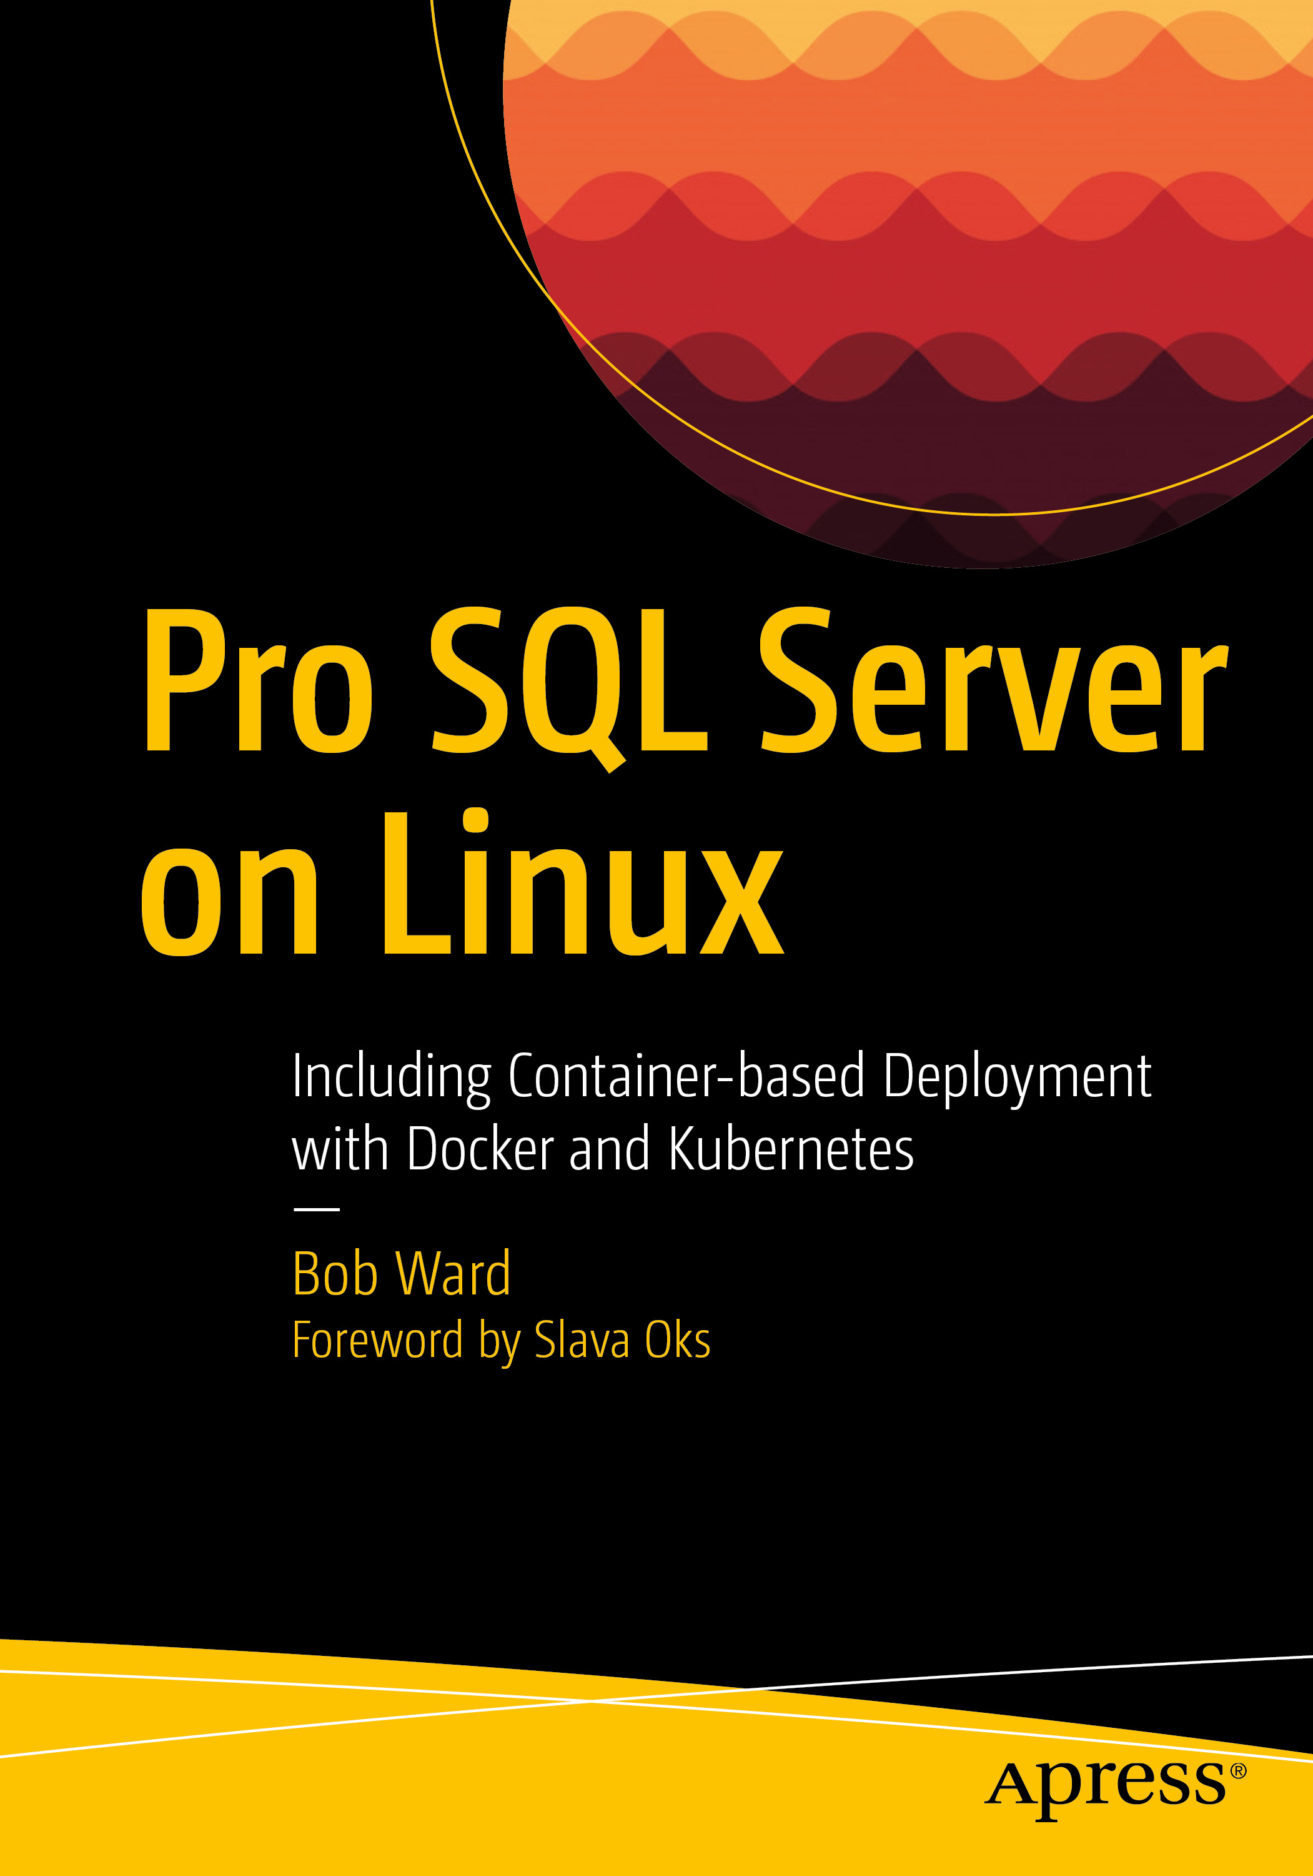
Learn more
Preview SQL Server 2019 now: https://aka.ms/ss19
Join the early adoption program: https://aka.ms/eapsignup
See what’s new in SQL Server 2019: http://docs.microsoft.com/sql/sql-server/what-s-new-in-sql-server-ver15
http://aka.ms/bobwardms
http://aka.ms/bobsqldemos
http://aka.ms/sqllinuxbook

